Slide 1
Language
Corrections to and new language constants are delivered as MCE (Maintenance Corretion Entity)
Installation:
MT Cloud – No action required
ST Cloud - On request to CloudOps
OnPrem – Use Life Cycle Manager (LCM)

Slide 2
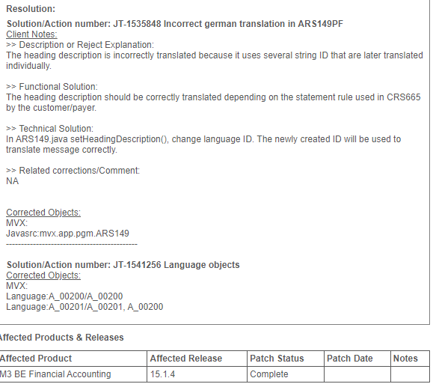
Language handling via LCM

Slide 3
Language handling via LCM
Log into LCM
Open Grid Space where you want to install
Right-click on the M3BE at the bottom and select “Retrieve MCE”
You need to log on with your Infor Support/Concierge user
Select your M3 version and search for the ID in the solution from Infor

Slide 4
Language handling via LCM
Use the «Retrieve» button to retrieve the MCE

Slide 5
Language handling via LCM
Installation
Rightclick M3 BE inside grid
Select Fixes and manage fixes

Slide 6
Language handling via LCM
Find the correct solution and Apply it.

Slide 7
Language handling via LCM
When finished you will receive a message of what to do.

Slide 8
Language handling via LCM
To install it into M3; select “Import Database Data”

Slide 9
Language handling via LCM
Please be aware the choice of stopping M3

Slide 10
Language handling via LCM
Use Administrator login
Select “Import Database Data”

Slide 11
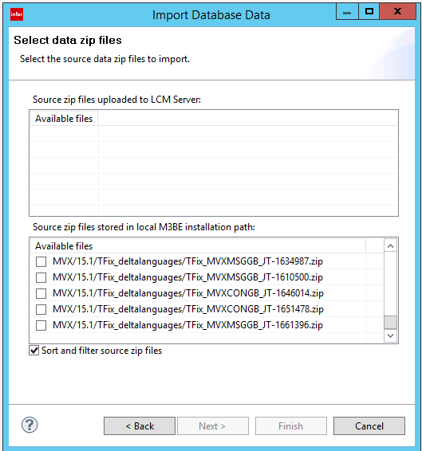
Language handling via LCM
Find your solution

Slide 12
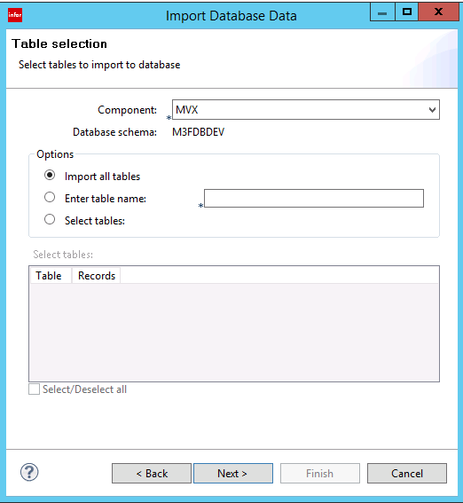
Language handling via LCM
Import it to the correct Component

Slide 13
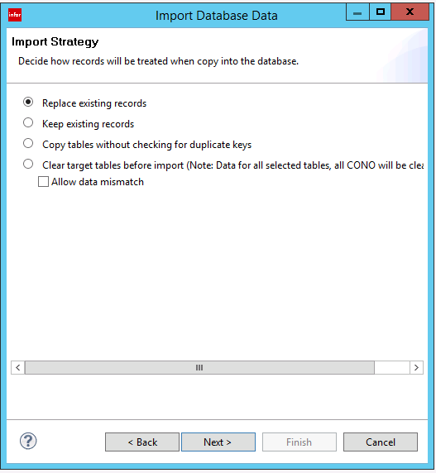
Language handling via LCM
Normally Replace existing records

